Slide 1

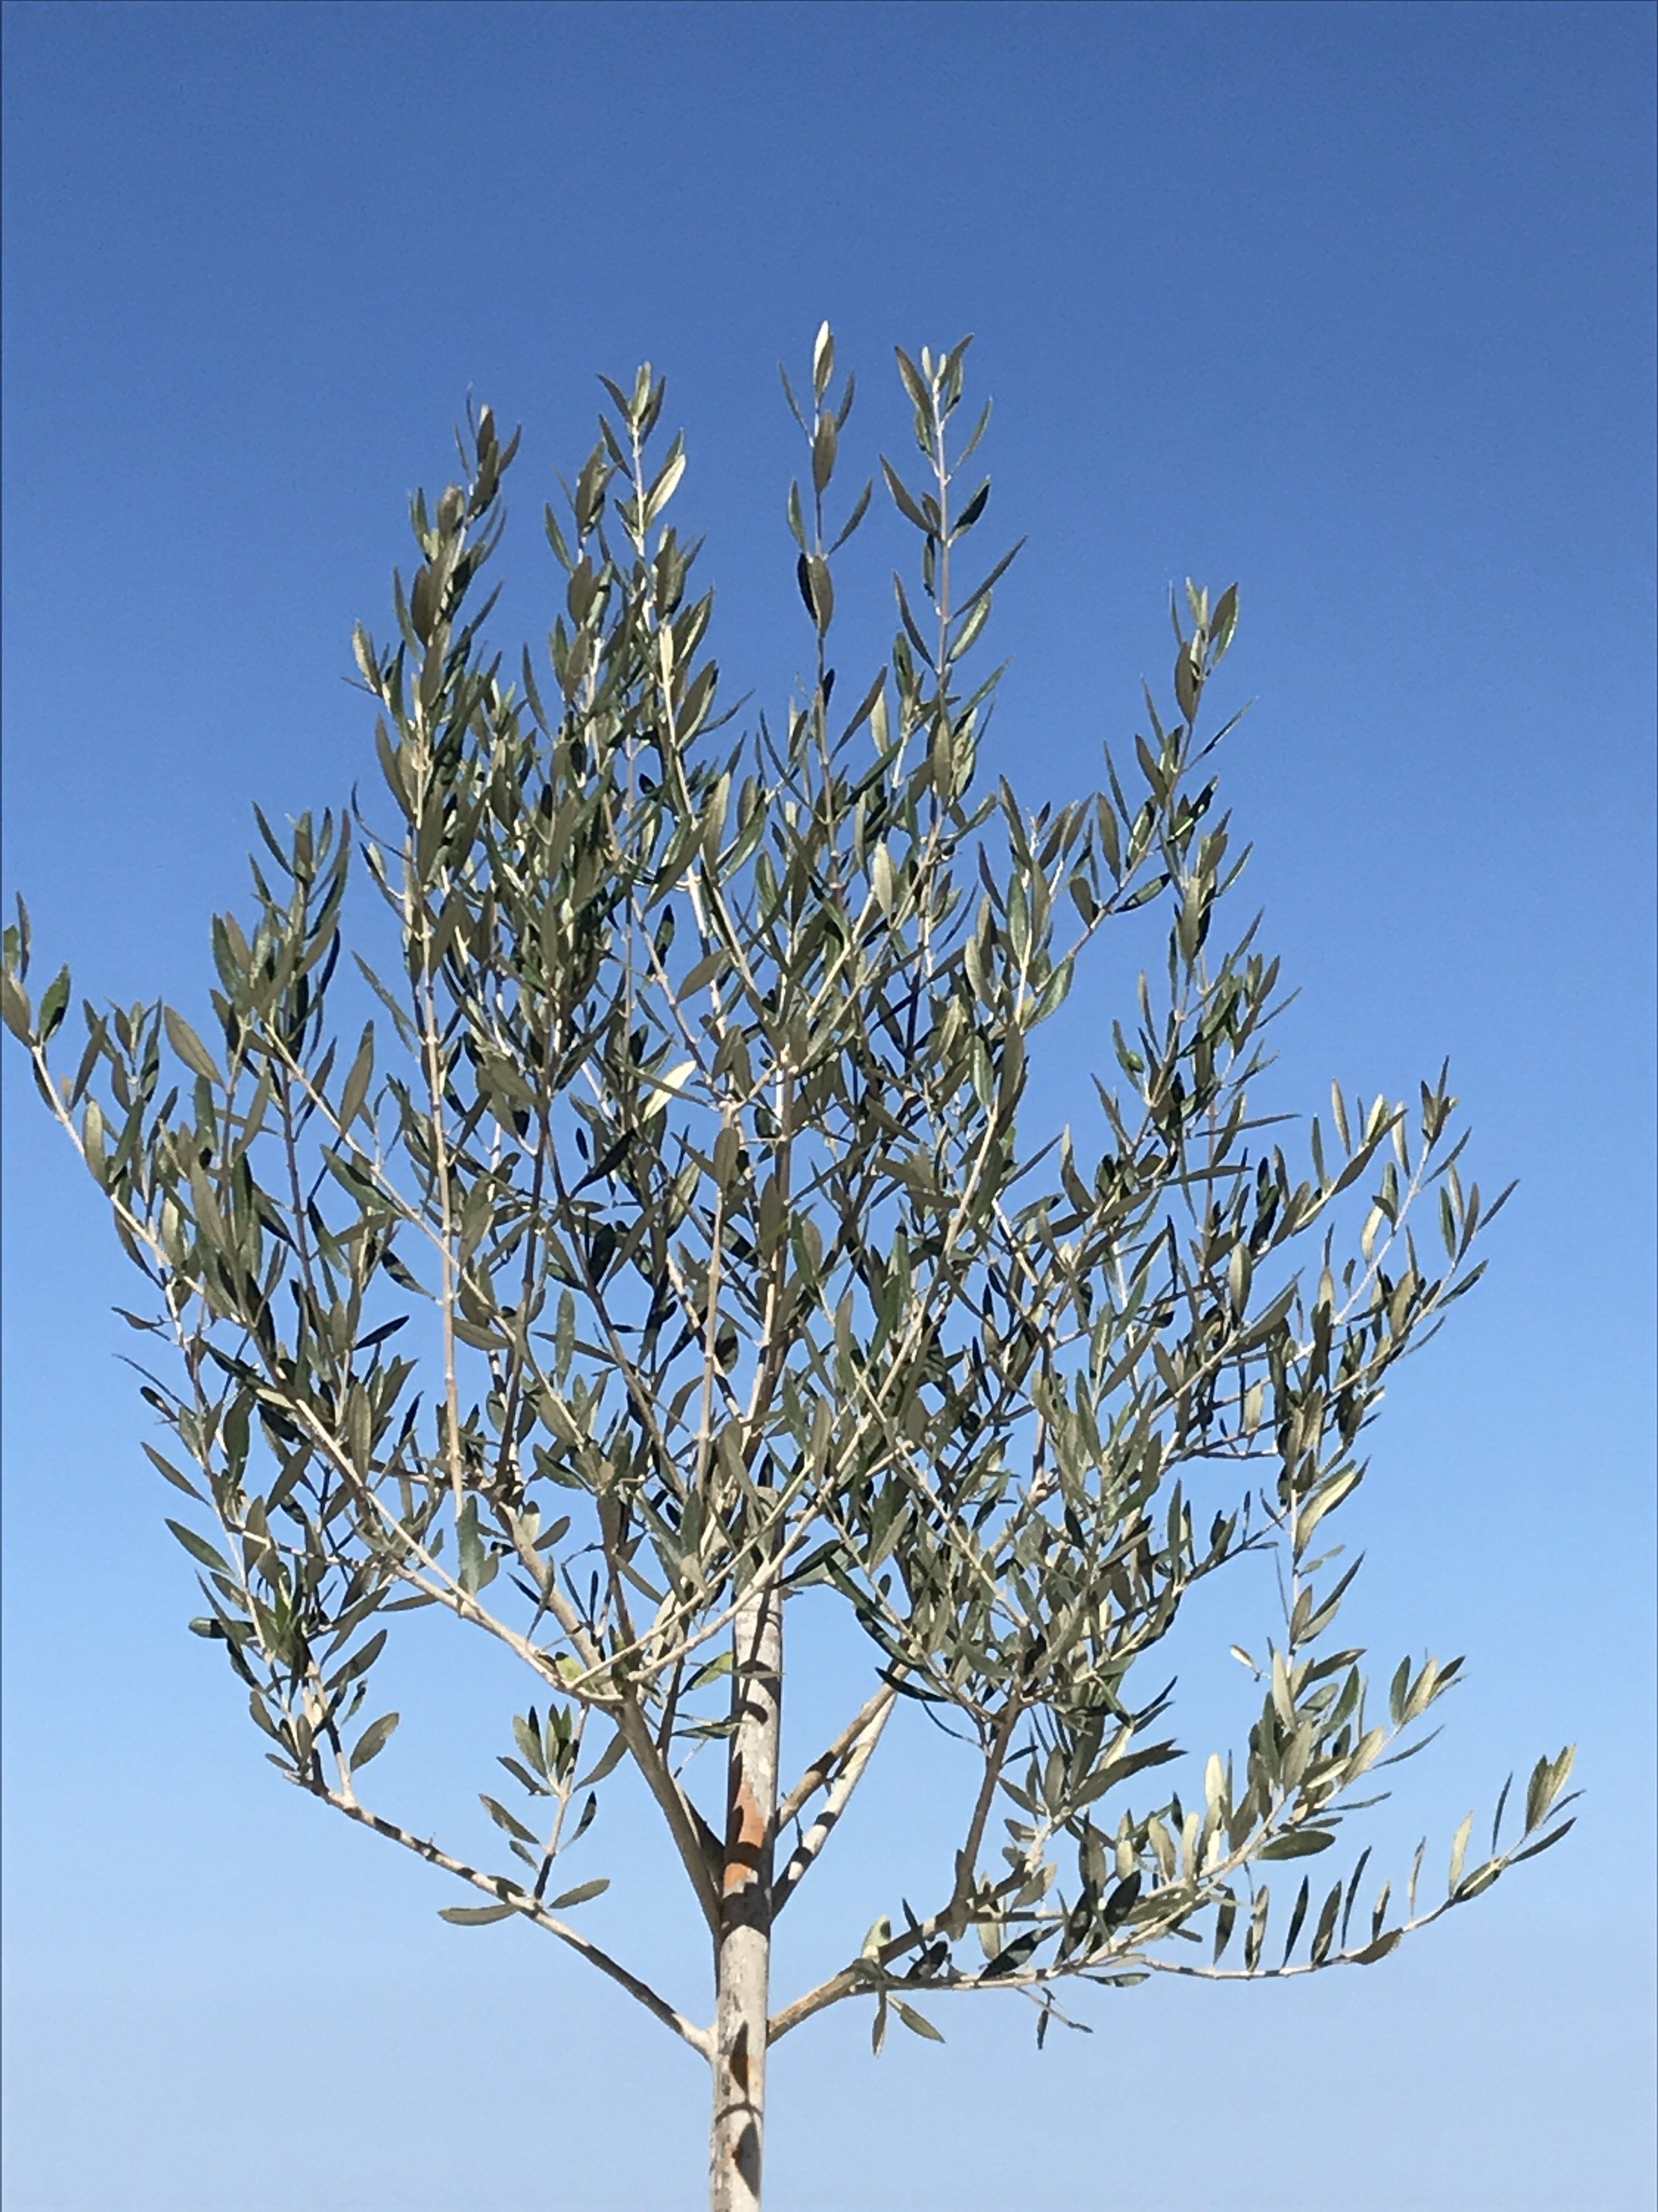
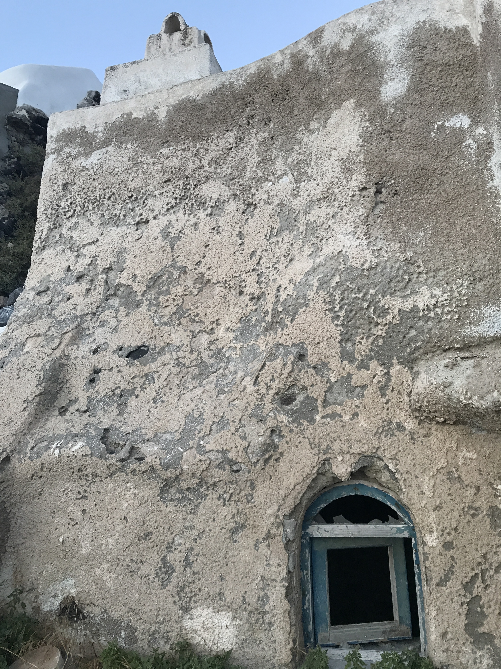
Slide 1
titus

Slide 2

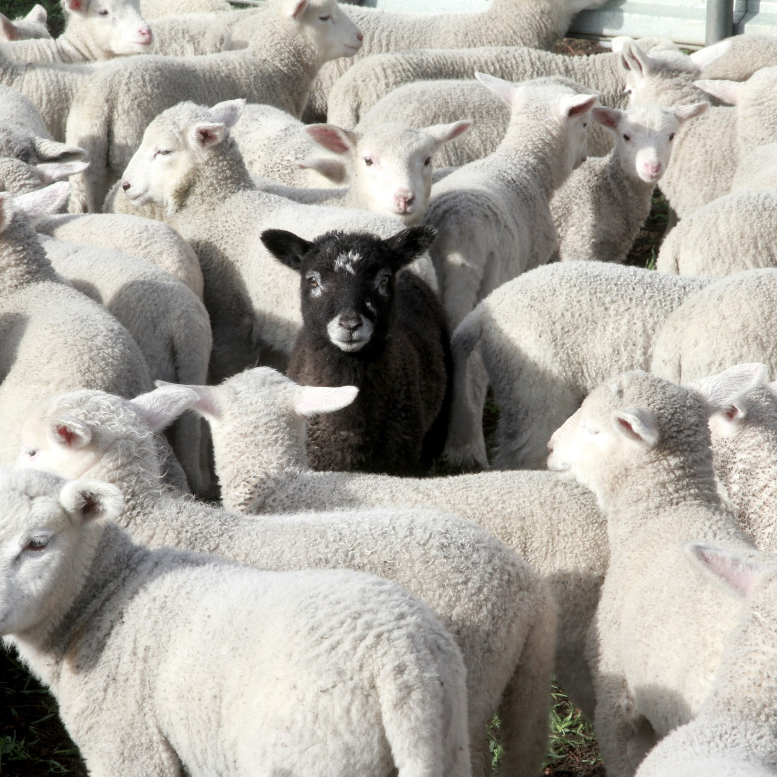
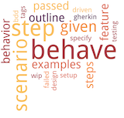
titus
Chapter 1
Chapter 2
Chapter 3
Appoint Leaders
Good models are so important
Be Counter Cultural Cretans
Good lives glorify God (2:4, 8, 10).
Believe before behave
We do what is right in response to God’s kindness to us (3:3–7).

Slide 3



Titus 1
Introduction (1-5)
Troublemakers (10-16)
Who is Paul
What is Paul’s role
Who is Titus
What Paul wants done
Dishonest speech, dishonest gains, they’re a pack of good for nothings!
Good leaders (6-9)
The type of people Titus should pass the baton on to
Take away
Should not vs. need not

Slide 4
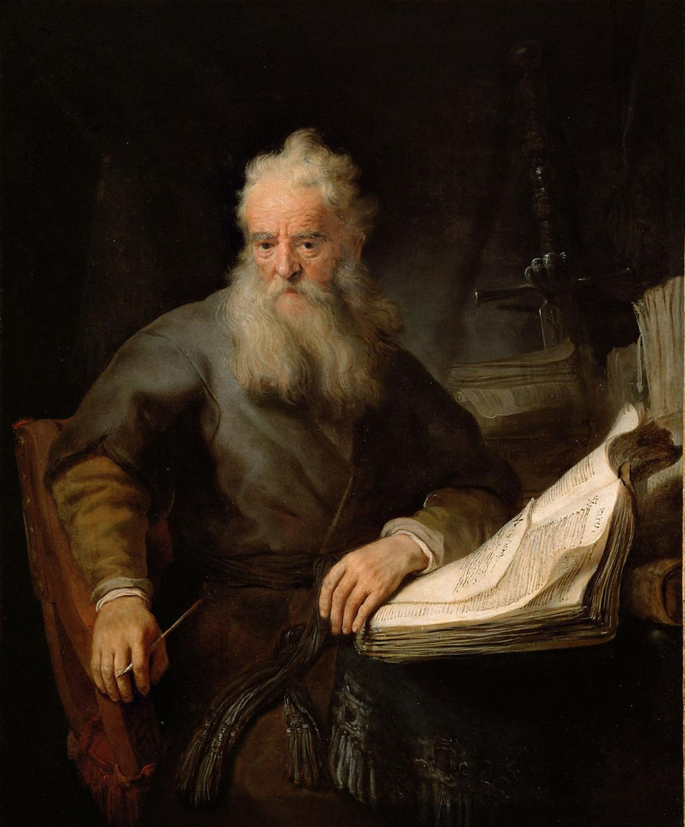


Titus 1
Who is Paul
What he wants done
What is his role

Slide 5


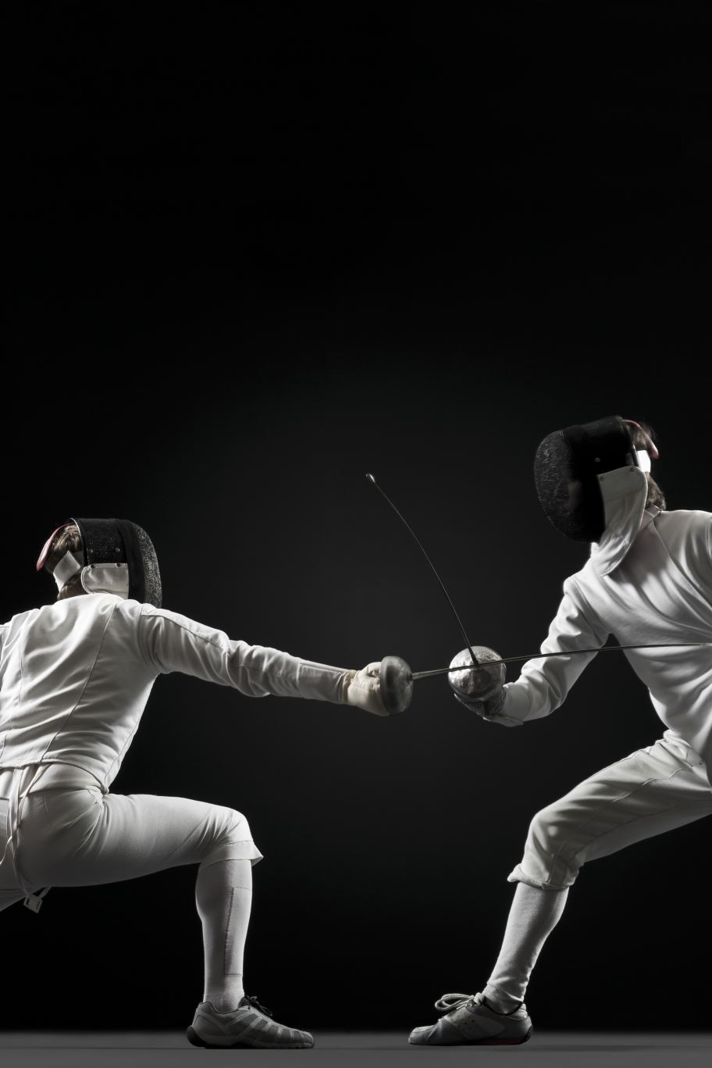
Titus 1
Who is Paul
Character
What he wants done
Good leaders
What is his role
Competent

Slide 6
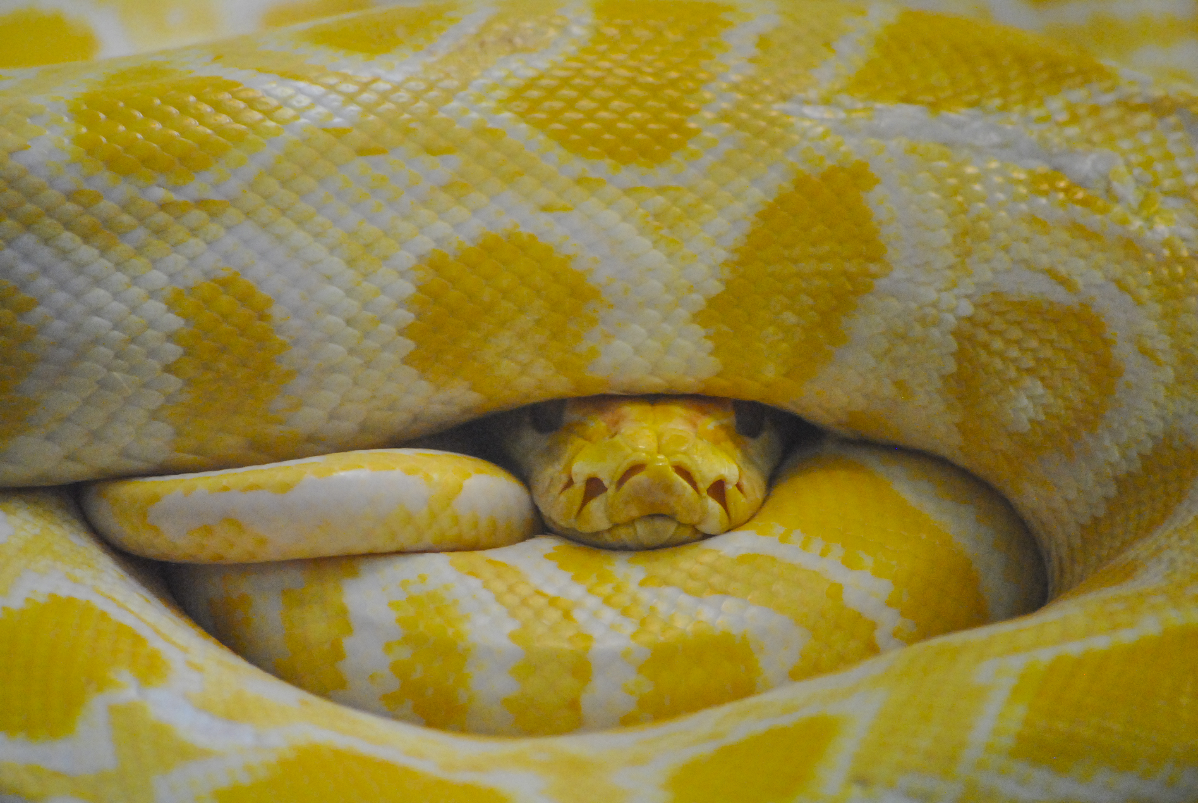

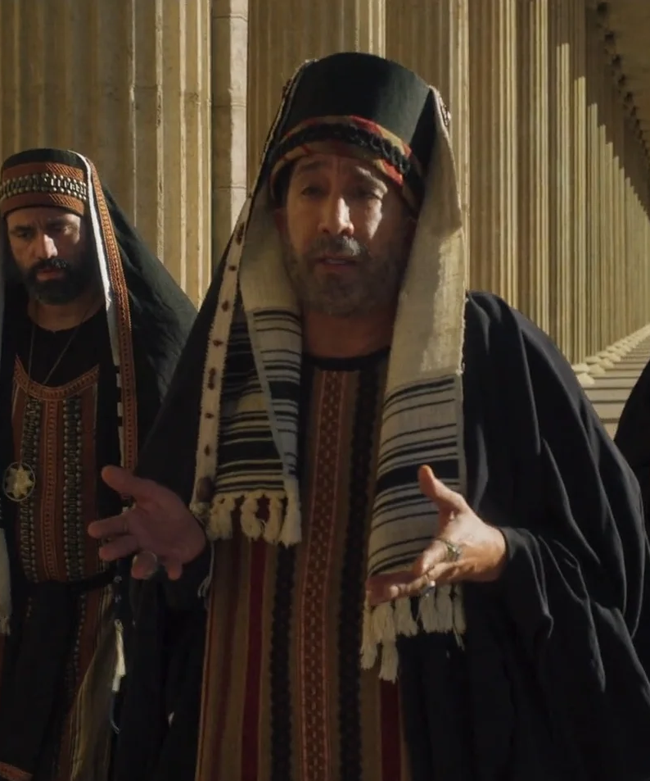
Titus 1
Who is Paul
Character
What he wants done
Good leaders
What is his role
Competent
Troublemakers
Legalistic
Rebellious

Slide 7



Titus 1
Who is Paul
Character
What he wants done
Good leaders
What is his role
Competent
Troublemakers
Take away
Need not
Legalistic
Should not …
Rebellious

